Slide 1
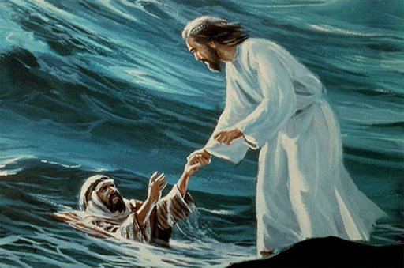
Hold My Hand O Lord

Slide 2
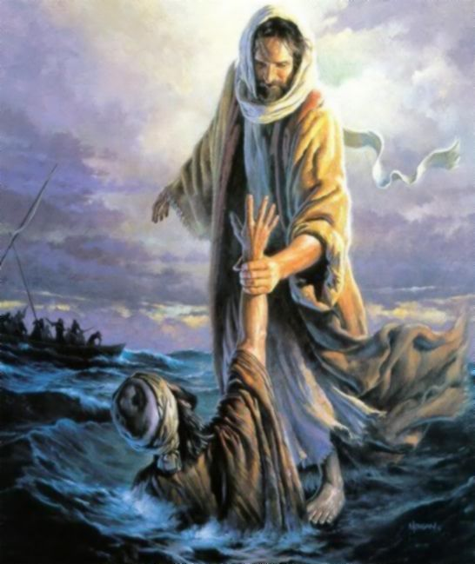
Hold my hand O Lord like you held Peter’s hand
When he started to drown you gently held his hand

Slide 3
Lifted him over the waves and made him feel safe (2)
And me too O Lord hold my hand (2)

Slide 4
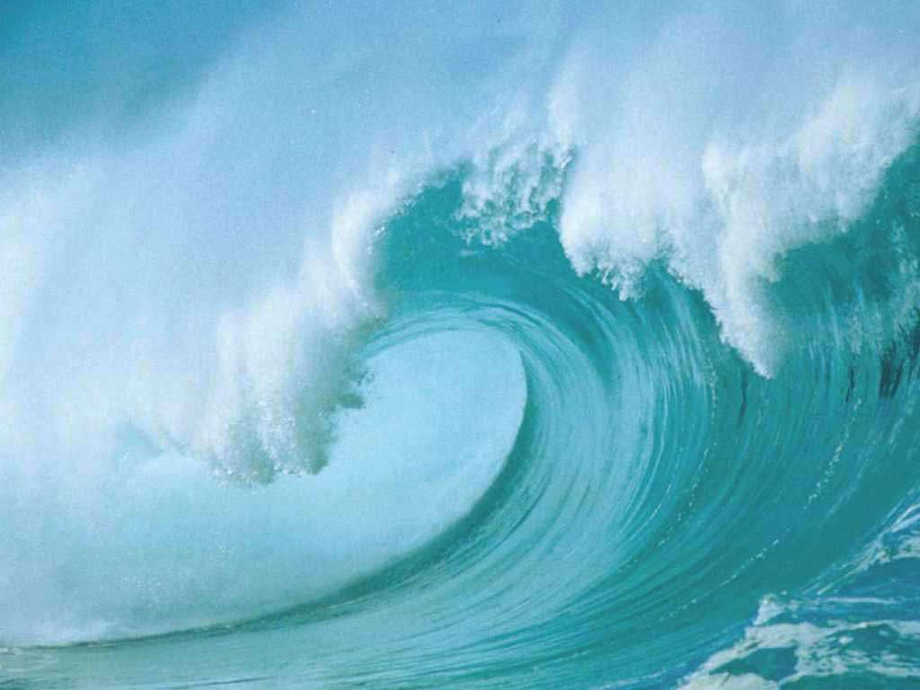
The waves are strong for me. Makes my heart tremble
And the winds O lord are strong I’m not, able to stand

Slide 5
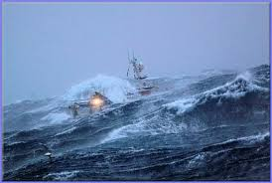
When the ship goes up and down
and rocks are in the way (2)
Tell the waves to be calm and hold me in your arms (2)

Slide 6
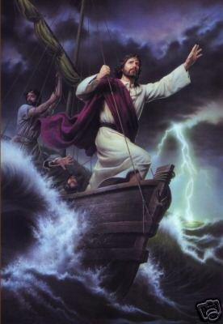
Enter my ship O Lord and also in my life
Cast my fear away and heal all my pain

Slide 7
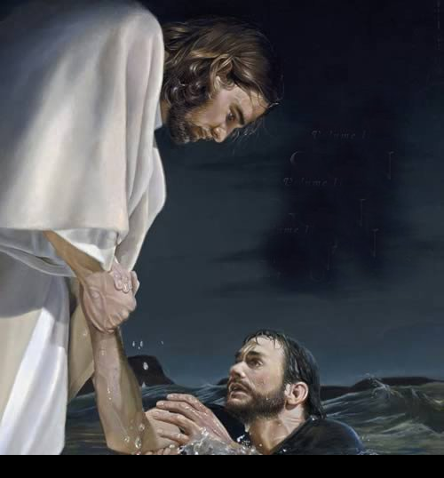
And dwell in my heart and fill it with your peace (2)
Never leave me alone to walk in my path (2)

Slide 8
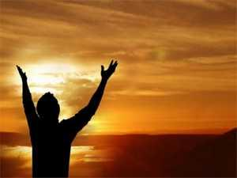
My faith O Lord is weak Strengthen my faith
And if I ever doubt you or get lost in the way

Slide 9
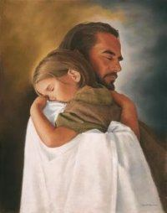
Bring me back to live with you, all my life (2)
You are my father Lord your heart is full of love.

